Slide 1
Reflective Practice
GNED400 – K Pandolfi

Slide 2
Reflective Practice
“Learning from experience”
Thinking back on our own actions
Thoughts for personal learning and development
Think of the positive and negative aspects of your experience
Think of the consequences of certain actions
Think of what could have been done differently
Notes:
https://i.ytimg.com/vi/3R5jdvKIlho/maxresdefault.jpg

Slide 3
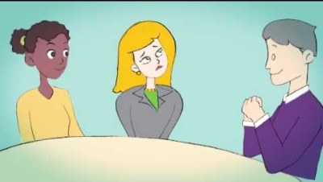
Reflective Practice

Slide 4
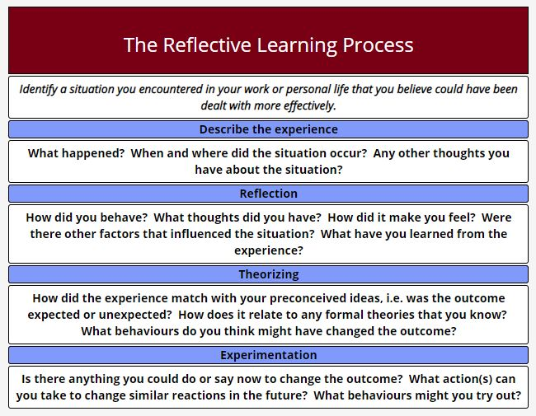

Slide 5
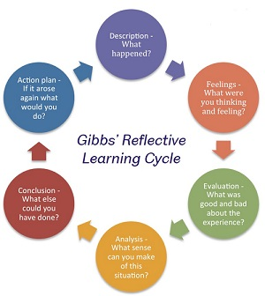
Gibbs’ Reflective Cycle
Gibbs’ Reflective Learning Cycle shows the process of thinking for reflective practice
The steps in this cycle are: Description,
Feelings, Evaluation, Analysis, Conclusion
and Action Plan
Notes:
https://www.sheffield.ac.uk/ssid/301/study-skills/university-study/reflective-practice

Slide 6
Reflective Practice Models
What?
Rolfe’s Framework
What ...is the problem? ...was my role? ...happened? ...were their consequences?
So what ...was going through my mind? ...should I have done? ...do I know about what happened now?
Now what ...do I need to do? ...broader issues have been raised? ...might happen now?
Source: What is Reflective Practice.
Mind Tools: The Skills You Need
What Next?
So What?

Slide 7
Using Reflective Practice
Small Scale
Large Scale
Personal life experiences
Career development
Learning plan
Truth & Reconciliation
Recognize the ongoing trauma caused by residential and day schools; it is also an opportunity to commit to the process of truth, reconciliation, and justice with Indigenous Peoples
Restorative Justice
Strategic Planning
Consider all aspects to ensure the organization and stakeholders benefits fully

Slide 8
Why is reflective practice important?
Improve self-awareness.
Develop creative thinking skills.
Understanding others through emotional intelligence.
Learning from experience to improve future performance.

Slide 9

Activity:
Think of a recent situation that made you feel upset, misunderstood, or mad
Analyze what was going on in that situation and what caused you to feel those emotions. Think about Who? What? Where? When? Why?
Was there a good or bad outcome from the situation?
What did you learn from the situation?
NOW….
Reflect on how you reacted to the situation.
Could you have handled the situation in a better manner?
What will you do differently next time you’re placed in a situation like that?

